Slide 1
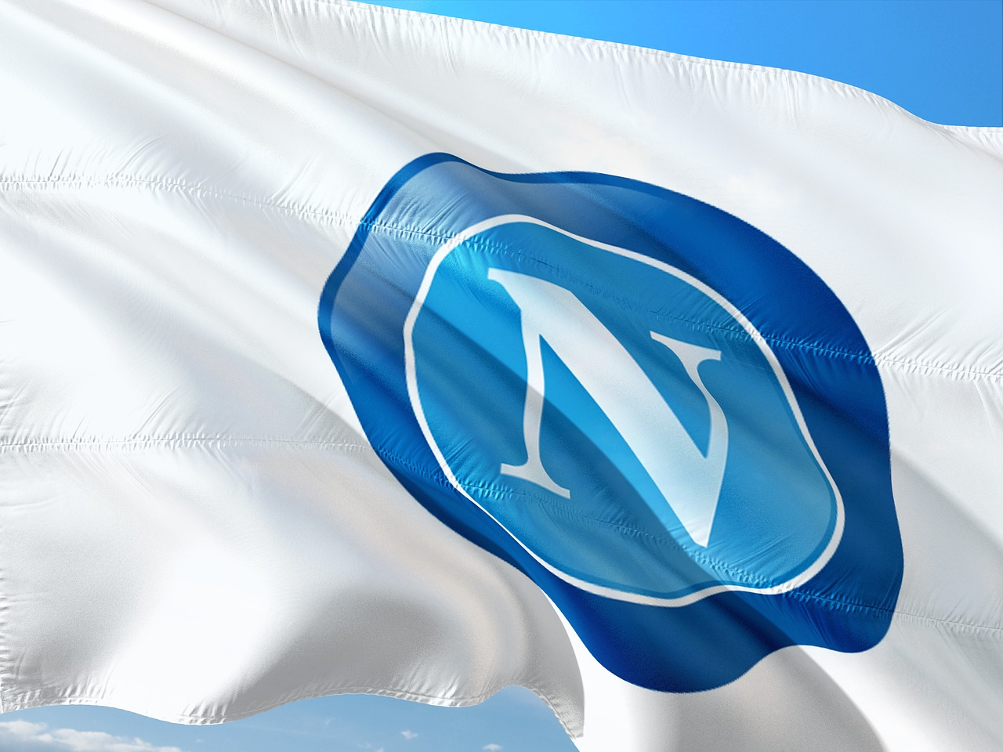
How Can Napoli Avoid a Capitulation and Sustain Their Title Challenge?
By Kosta Marcopulos

Slide 2
Napoli’s History
2004 – Napoli go bankrupt. Relegated to Serie C
1961/62 – Napoli win their first Copa Italia
1986/87 – Napoli win their first Scudetto
1989/90 – Napoli win their second Scudetto
1926 – Official founding of SSC Napoli
1984 – Signing of Diego Maradona
1988/89 – Napoli win their first UEFA Cup
1991 – Maradona era ends at Napoli
2004 - Present – Era of De Laurentiis

Slide 3
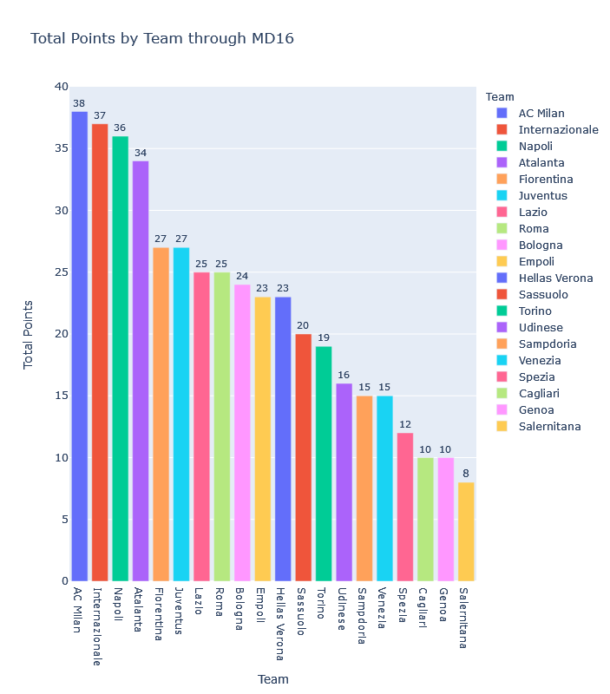
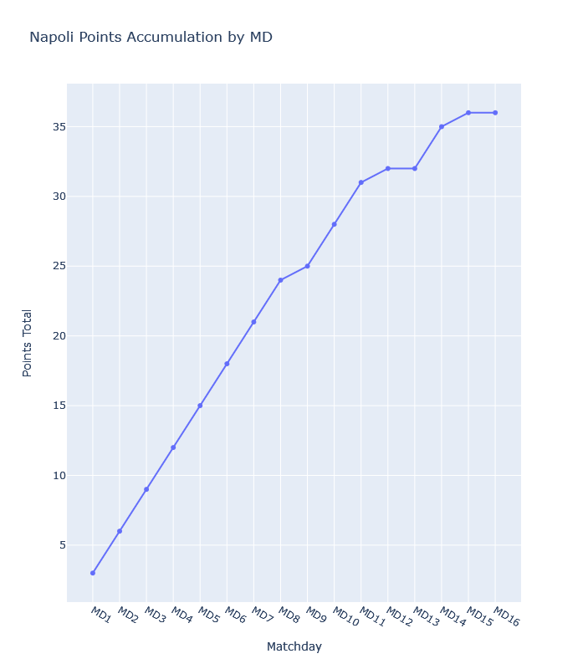
Napoli’s Current Situation
MD | PPM
1-11 | 2.82
12-16 | 1.00

Slide 4
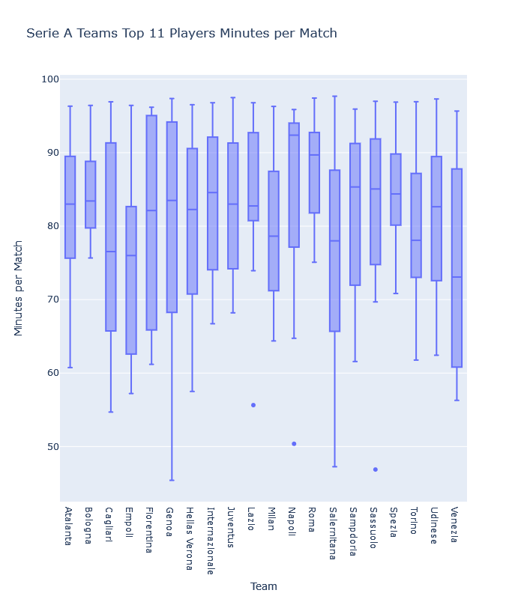
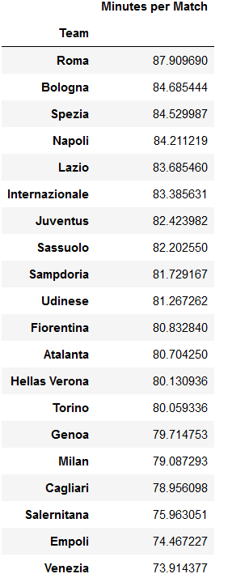
The Problem -Injuries
Team | Top 11 Median Minutes Per Match
Atalanta | 83.0
Inter | 84.6
Juventus | 83.0
Lazio | 82.8
Milan | 78.6
Napoli | 92.4
Roma | 89.7

Slide 5
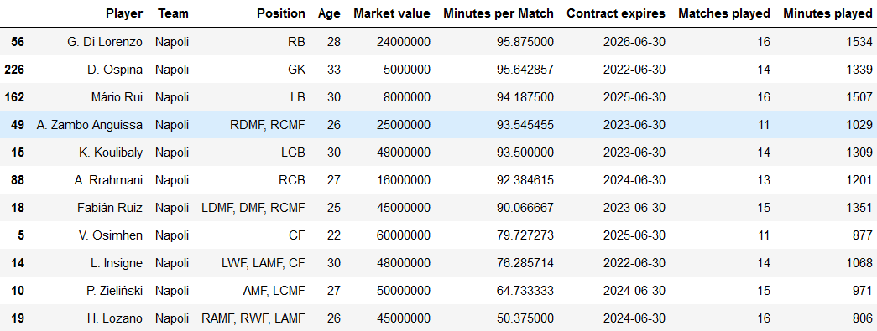
The Problem -Injuries

Slide 6
Transfer Targets - Criteria
Must be a player in Serie A.
Must have at least 630 minutes of play time in their domestic competition.
Philosophy – A team’s defense is as bad as their worst defender and their attack is as strong as their best attacker.
Restrict number of signings to two players. This is due to the fact that they were crippled financially from COVID and missing out on Champion’s League revenues. This also ensures they don’t overspend, preventing them from signing Zambo Anguissa on a permanent basis.

Slide 7
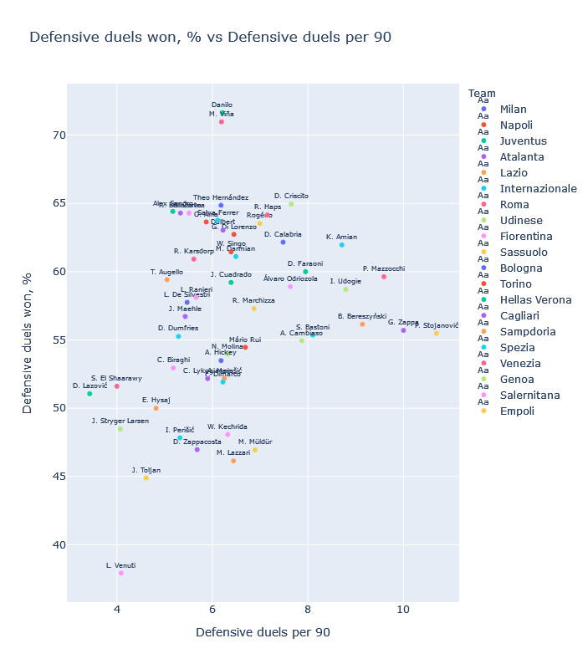
Full Back - Defense
Player | Club | Defensive Duels Per 90 | Defensive Duel Win %
Di Lorenzo | Napoli | 6.45 | 62.73%
Mario Rui | Napoli | 6.69 | 54.46%

Slide 8
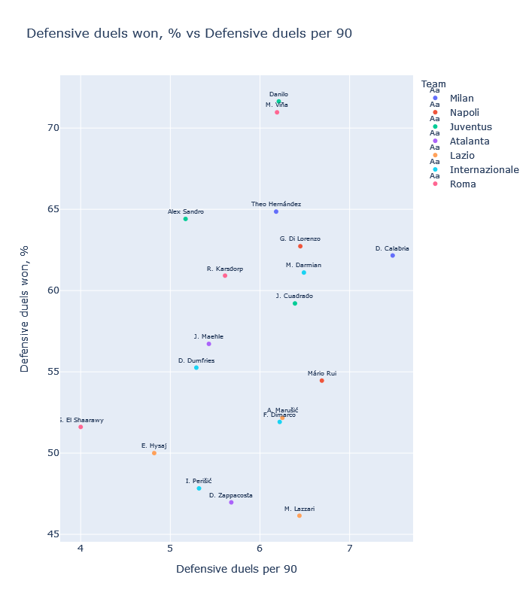
Full Back – Defense (Top 7 Clubs)
Player | Club | Defensive Duels Per 90 | Defensive Duel Win %
Di Lorenzo | Napoli | 6.45 | 62.73%
Mario Rui | Napoli | 6.69 | 54.46%

Slide 9
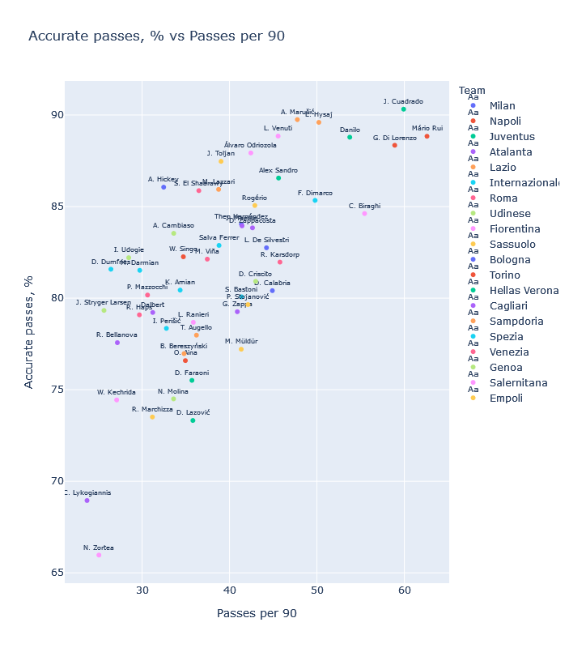
Full Back - Passing
Player | Club | Passes Per 90 | Accurate Pass %
Di Lorenzo | Napoli | 58.90 | 88.35%
Mario Rui | Napoli | 62.59 | 88.84%

Slide 10


Full Back - Rogério
Player | Club | Defensive Duels Per 90 | Defensive Duel Win % | Passes Per 90 | Accurate Pass %
Rogério | Sassuolo | 6.99 | 63.53% | 42.90 | 85.06%
Mario Rui | Napoli | 6.69 | 54.46% | 62.59 | 88.84%

Slide 11
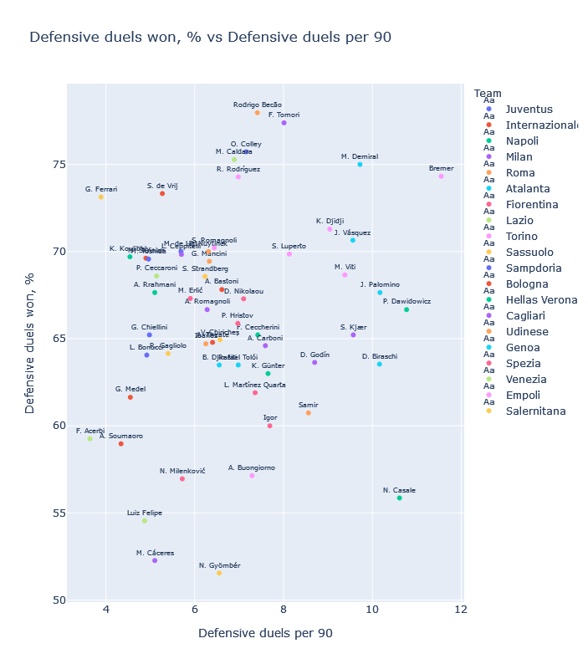
Center Back- Defense
Player | Club | Defensive Duels Per 90 | Defensive Duel Win %
Koulibaly | Napoli | 4.54 | 69.70%
Rrahmani | Napoli | 5.10 | 67.65%

Slide 12
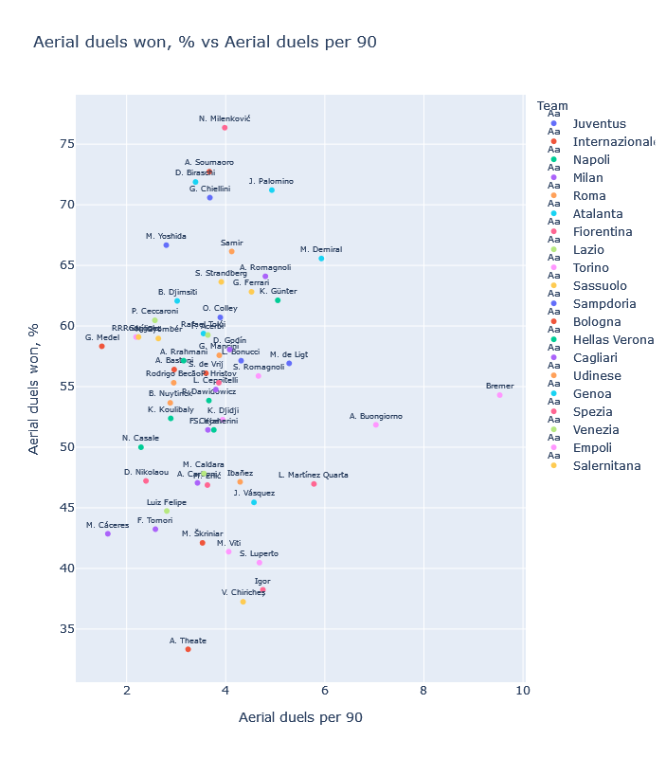
Center Back- Aerial
Player | Club | Aerial Duels Per 90 | Aerial Duel Win %
Koulibaly | Napoli | 2.89 | 52.38%
Rrahmani | Napoli | 3.15 | 57.14%

Slide 13
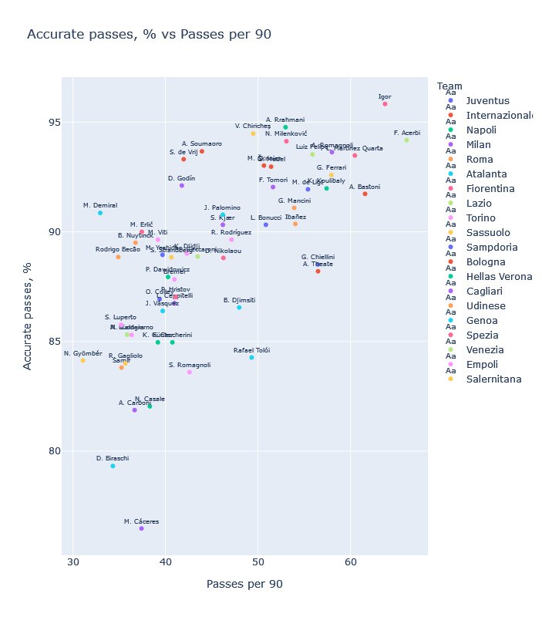
Center Back- Passing
Player | Club | Passes Per 90 | Accurate Pass %
Koulibaly | Napoli | 57.41 | 91.98%
Rrahmani | Napoli | 52.98 | 94.77%

Slide 14



Center Back – Demiral & Ferrari
Player | Club | Defensive Duels Per 90 | Defensive Duel Win % | Aerial Duels Per 90 | Aerial Duel Win % | Passes Per 90 | Accurate Pass %
Demiral | Atalanta | 9.72 | 75.00% | 5.93 | 65.57% | 32.95 | 90.86%
Ferrari | Sassuolo | 3.89 | 73.13% | 4.52 | 62.82% | 57.93 | 92.59%
Koulibaly | Napoli | 4.54 | 69.70% | 2.89 | 52.38% | 57.41 | 91.98%
Rrahmani | Napoli | 5.10 | 67.65% | 3.15 | 57.14% | 52.98 | 94.77%

Slide 15
Conclusion
1) Napoli's league form has taken a significant dive, which is reflected in their average points per match from Matchday 1-11 compared to Matchday 12-16. During their previous 5 matches, injuries became a common theme within the club.
2) When looking at every Serie A team's top 11 players with the most minutes played, it is evident that Napoli are relying on a core group of players more than their counterparts. No other club's top 11 players have a minutes per match median above 90 minutes, while Napoli's is at 92.39 minutes. This is further skewed as we know players like Osimhen and Insigne have been removed early from matches involuntarily due to injuries and a red card.
3) Based on the data, we identified both Rogerio as a leftback and Ferrari as a central defender. This will provide more cover in the positions that have players with the most minutes played. Increased rotation should decrease the chances of fatigue related injuries.
4) A common theme regarding our shortlists are players from Sassuolo. As they employ a similar play style and recruit players with strong metrics in key areas, it would be wise for Napoli to earmark the club as a potential pipeline of talent.

